Slide 1
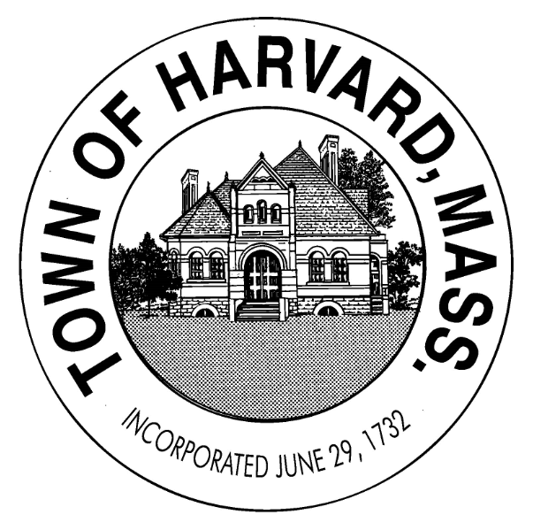
Town of Harvard
Draft OSRD Bylaw Review
Session 3 – Current Bylaw
Part 1: Administrative
Part 2: It’s All About the Open Space

Slide 2
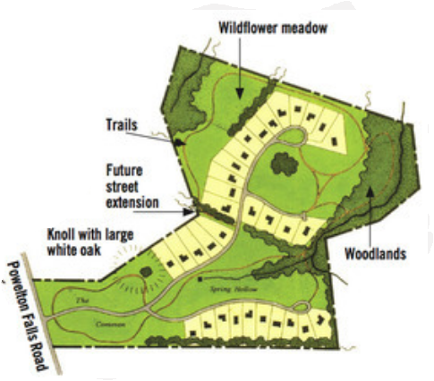
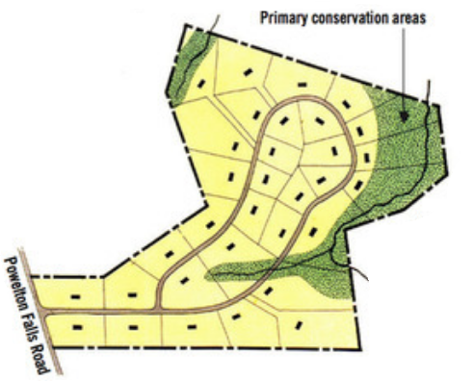
MAIN IDEA: Open Space Residential Development (OSRD)
Vs.
Open Space Residential Development
(OSRD)
Conventional Zoning
32-33 Single Family Homes on the same acreage

Slide 3
CAUTION!!!
Boring information ahead.
Please caffeine up and have a sharp pencil ready for jabbing your leg!

Slide 4
OSRD Review Schedule
June 21 - Current Bylaw and MRPC Work (Completed: see prior PPTs)
July 19 – Administrative and Open Space – Proposed 125-35A-E
August 2 – Density of Development – Proposed 125-35F
August 16 – Types of OSRD, Types of Units – Proposed 125-35G
September 13 – Uses in OSRD – Proposed 125-35G-H
September 20 – Dimensions and Design – Proposed 125-35I
September 27 – Process – Proposed 125-35J-K

Slide 5
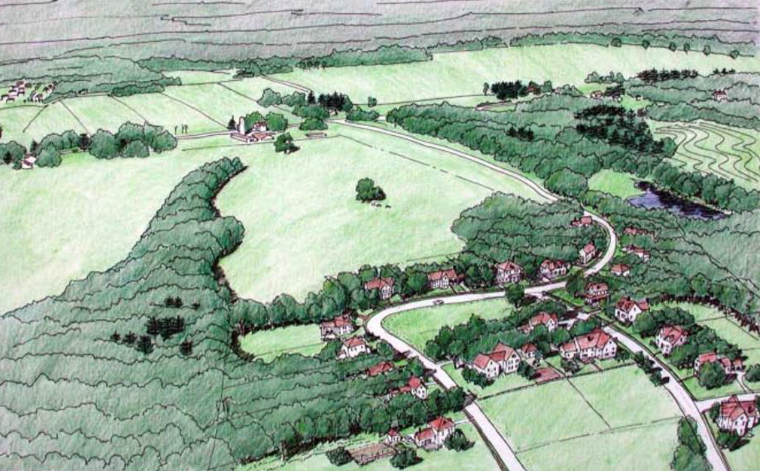
RECAP
Open Space Residential Development is an increasingly popular alternative to conventional subdivision design. It is intended to set at least 50 percent of the parcel area aside as permanently protected open space.
It can be done as a subdivision or a unified site plan.
The regulations may be a bit more complex to ensure that the open space and the design are done well.
Harvard has had a version since 2003 but it has not worked. See June 21 PPT for a summary of the current Bylaw.

Slide 6
Anatomy of a Bylaw
Proposed Replacement Section 125-35 of the Town of Harvard Protective Bylaw
Section A – Purpose and Intent
Section B – Applicability
Section C – Definitions
Section D – Open Space
Section E – Development Density
Section F – Permitted Uses
Section G – Conditional Uses
Section H – Dimensional and Design Requirements
Section I – Project Site Design Process
Section J – Formal Process and Application
Next for Discussion

Slide 7
Administrative Provisions
There are three primary general or administrative provisions in the OSRD bylaw. These are:
A - Purpose and Intent: These establish the purpose of the bylaw and its intent as to what it is accomplishing.
C - Applicability: How does the bylaw apply, what does it do?
D - Definitions: Better situated in a consolidated definitions section, they are sometimes located in a specific bylaw section due to the very technical and specific nature and applicability of the definitions. We can be flexible about this.

Slide 8
Village-like areas
Reference to master plan actions

Slide 9
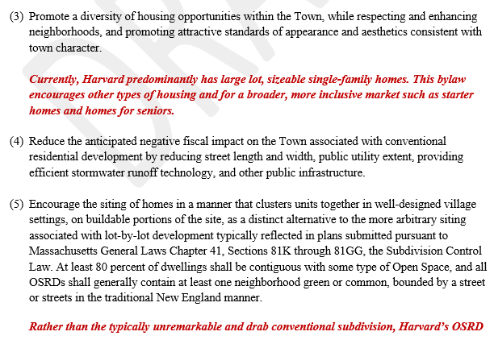

Slide 10
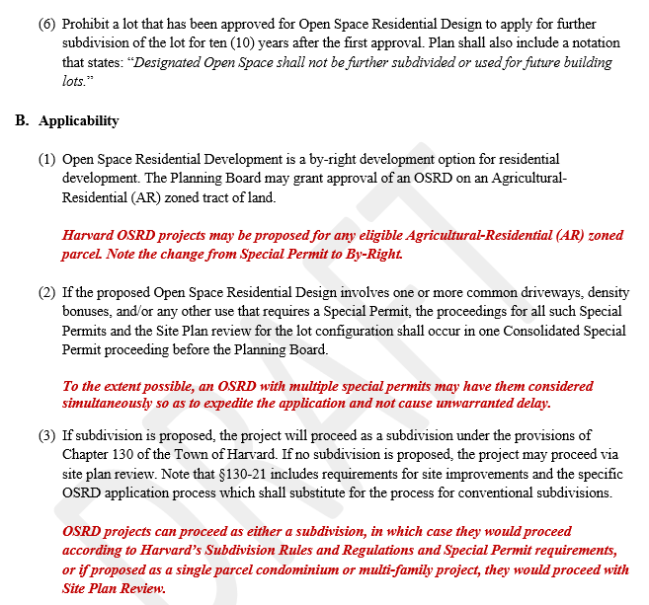
By-right or as-of-right is an important change for this bylaw and may be uncomfortable for the public
If special permits are required, they should be concurrently adjudicated. May also wish to consider a unified permitting process similar to Devens
**
Likely that most Harvard OSRD projects will not be S/D due to sewerage issues.

Slide 11
Interlude Question: “Why would a developer ever use a more lengthy, complex, and expensive process than a standard subdivision?”
Answer: It is a balancing act. In exchange for a little more work and coin, the developer has a predictable process and can gain density bonuses for a better ROI. Additionally, OSRD development costs can be substantially lower due to less infrastructure and profits higher due to the proximity effect of open space on valuations.
CONVENTIONAL
OSRD

Slide 12
Conservancy Lots
Critical Wildlife Habitat
Mature Woodlands
Net Acreage
Open Space
Passive Recreation Area
Pocket Neighborhood
Primary Resource Protection Area (PRPA)
Secondary Resource Protection Area (SRPA)
Shall Generally
3 Key Definitions

Slide 13
What is Open Space?
There are as many different answers to that question as people asked. The term conjures up various images to different people. For example, a recreation director might think of supervised, improved playgrounds while a hiker might envision natural areas undisturbed by [people]. It is important that those concerned with open space clearly define exactly what they mean when using the term.
This is especially true for those involved with public policy. Planning Board members may envision the dedication as a natural area. Others, such as the public, might fear that the open space would eventually become an improved park generating lights, noise, dust and beer swilling teenagers. It is important that the Board clearly define the proposed use and design of the open space. It is important that these potentially valuable open areas are not viewed as undesirable sites posing maintenance and liability problems, or as weed growing, lots scattered throughout the town.
Harvard needs to be very clear and definitive about what open space will be in the context of this type of zoning so that it will not be a potential source of opposition.

Slide 14
Open Space - Negative and Positive Views
For some, open space can be viewed as a negative concept. We can’t assume everyone is a strong supporter of open space preservation. Open space was once referred to as “the nothing between something.” This view treats open space as non-productive since it does not contain development or produce tax revenue. Behind this concept is the feeling that all land should ideally be developed. This view is severely limited.
Rather than having a negative economic impact on a community’s tax base, open space has proven to have quite the opposite effect. For example, in suburban areas single-family homes often do not pay enough tax revenue to cover the cost of public services they receive. Open space demands little or no service and so costs the town very little. Studies in several New England Communities have confirmed the positive economic contribution of open space as opposed to uncontrolled single-family home development. Another positive aspect is that property values of land next to open space increase, and in turn, produce increased property tax revenue.
Where open space attracts visitors, tourist/visitor expenditures can significantly contribute to the local economy. Some public lands are rented generating direct income. In conclusion, open space can be a positive land use that each community should seek to encourage.

Slide 15
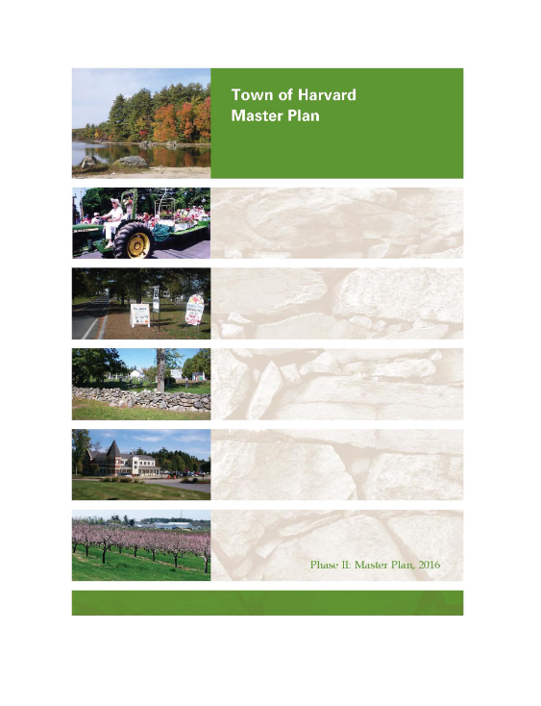
Open Space and Harvard Long Range Planning
Harvard has long valued protecting valued open space. Numerous master plans and open space and recreation plans include goals and actions for the protection of open spaces.
For example, the 2016 Master Plan established a key goal:
“Harvard engages in judicious stewardship of natural, historic and cultural resources.” This goal includes:
Identify and protect critical natural resource areas
Restore and/or maintain key viewsheds
Preserve the town’s defining landscapes that are valued by Harvard’s residents and reflective of the rural heritage.
Protect local watersheds
Preserve historic structures and locations

Slide 16
Open Space and Harvard Long Range Planning
Chapter 3, Natural Resources and Open Space, Section 4 (Open Space, p. 36) extolls the “Over 25 percent of the town is protected in some way for conservation…”
Yet as the section also notes, “Some of Harvard’s most striking open space features are completely unprotected. This means they could be sold and developed at any time…”
While both the Conservation Commission and the Harvard Conservation Trust are active and very successful at adding to the inventory, this will not be sufficient to protect key parcels that are potentially developable as subdivisions and other uses.
Farms and large estates are expensive to maintain and owners may at some point seek to “cash out” for retirement or if they have no succession plan.

Slide 17
Open Space and Harvard Long Range Planning
The Master Plan Action Plan contains the following action items related to open space protection (adding to the items related to OSC-PRC discussed last meeting):
The 2016 OSRP contains the following action items related to open space protection (adding to the items related to OSC-PRC discussed on 6-21-21):
Protect, enhance and preserve the rural character and historic landscapes
Protect Harvard’s agricultural land
The 2016 OSRP also emphasizes protecting Harvard’s rural character and historic landscapes. This includes preserving and maintaining viewsheds, protecting agriculture, protecting water resources and wetlands, creating wildlife corridors, and preserving habitat.

Slide 18
Open Space in the Proposed OSRD Bylaw
Current Bylaw Draft Version 1 – May 2021
Open space is the central organizing principle of the OSRD Bylaw.
Open space for the purpose of this Bylaw shall be generally defined as:
“…areas of woodlands, fields, meadows, wetlands, and water resources, trails and other natural and man-made amenities not within individual building lots; and set aside for the use and enjoyment of residents, visitors and other persons, unoccupied by buildings or facilities unless related to recreational activities, and accessible to and adequate for persons and functions it is designed to serve. Generally, open space is intended to provide light and air and is designed for either conservation, scenic, or recreational purposes.”

Slide 19
Anatomy of a Bylaw
Proposed Replacement Section 125-35 of the Town of Harvard Protective Bylaw
Section A – Purpose and Intent
Section B – Applicability
Section C – Definitions
Section D – Open Space
Section E – Development Density
Section F – Permitted Uses
Section G – Conditional Uses
Section H – Dimensional and Design Requirements
Section I – Project Site Design Process
Section J – Formal Process and Application
Next for Discussion

Slide 20
If we can reasonably accomplish this level of specificity but also maintain the strength and energy of this part of the Bylaw, we may be successful. As noted earlier, length resulting from fine detail is not necessarily a weakness. It just needs to be clear and explainable. Why are these provisions in here? What is their purpose?

Slide 21
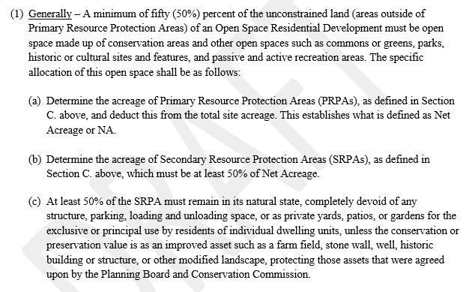
Comments
The foundational principle is to protect at least 50% of the parcel in open space.
The PRPA is essentially undevelopable. These are lands such as wetlands and steep slopes.
The SRPA is open space that is developable but desirable to protect.
As written, at least 75% of PRPA + SPRA must remain in natural state.
Open space areas are determined up front as Step 1 of the 4-step design process.

Slide 22
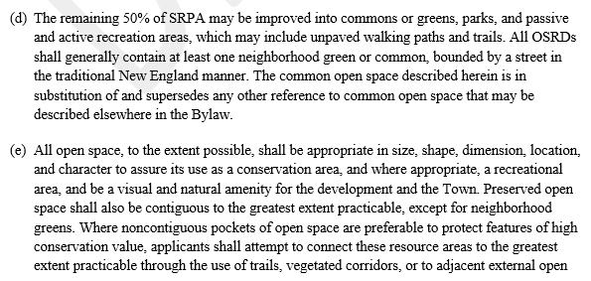
Comments
Important to integrate into OSRD plan a town green or town common typical of New England villages.
Open space shall be sized and shaped to be useable, contiguous, and designed for conservation value.
Exclusive use areas or yards are the last consideration in the 4-Step Process.

Slide 23
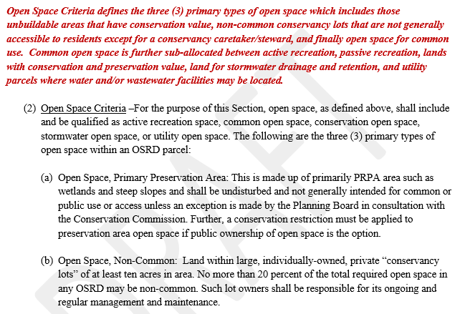
Comments
Three (3) types of open space:
Primary Preservation Area
Non-Common
Common Use
PRPA area is generally not buildable or contains important resources to protect.
Non-common are not typical but allowed and are conservancy lots in private ownership.

Slide 24
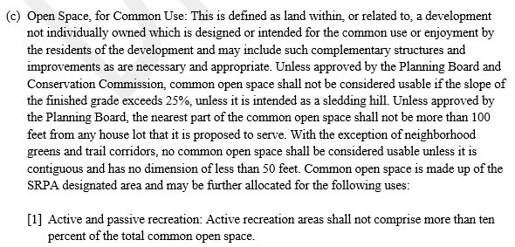
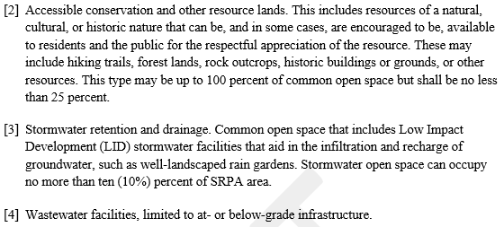
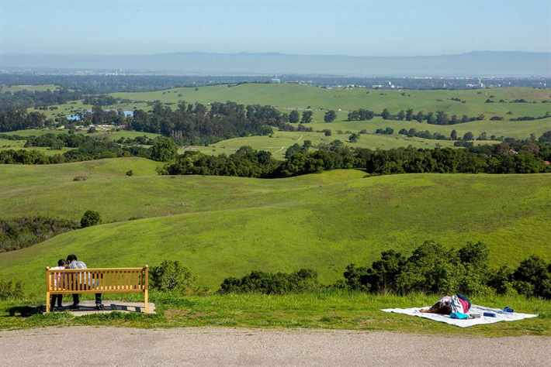
Comments
Common Use Open Space is that space used for common access and enjoyment by, at minimum, the residents of the development. Common Use Open Space is a part of the SRPA and can be used for:
Active and Passive Recreation
Conservation Lands
Stormwater or Wastewater Facilities

Slide 25
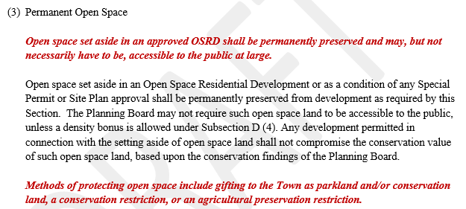
Comments
Permanent Open Space refers to the requirement that all open space in an OSRD is permanently protected and may never be used for any other land use.
This, in and of itself, does not mean that the OS is available for public access.

Slide 26
3 Types of Open Space in OSRD
Primary
Preservation
Area
Non-Common
Open Space
Open Space
For Common Use
1
2
3
This is the Primary Resource Protection Area (PRPA) land that is unbuildable by law or feasibility
These are conservancy lots owned and managed privately. They are not a common element in most OSRD development.
Common Use Open Space is that space used for common access and enjoyment by, at minimum, the residents of the development. Common Use Open Space is a part of the SRPA and can be used for:
Active and Passive Recreation
Conservation Lands
Stormwater or Wastewater Facilities

Slide 27
3 Types of Open Space in OSRD
Primary
Preservation
Area
Non-Common
Open Space
Open Space
For Common Use
1
2
3
Receives a partial credit for calculation of density.
Examples:
Steep Slopes – 50%
Transmission ROW – 10%
Wetlands – 95%
Open Water – 100%
Receives full credit for calculation of density
Receives full credit for calculation of density

Slide 28
Example Calculation of Open Space
Parcel Size = 20 acres with 2 acres steep slopes, 1 acre wetlands + Wetlands setback of 84,900 s.f. (2.94 acres)
Subtract PRPA → 20 – (2 x 0.5) + (2.94 x 0.95) = (2.94 x 0.95) = 16.21 acres
Subtract SRPA → 16.21 – 9 acres of woodlands, fields, stone wall, and small orchard = 7.21 acres buildable
Use 16.21 acres to calculate density at 0.67 units per acre = 11 units on 7.21 acres = 1.53 units/acre
Open Space = 3.79 acres PRPA + 9 acres SRPA = 12.79 acres on 20-acre lot or 64%

Slide 29
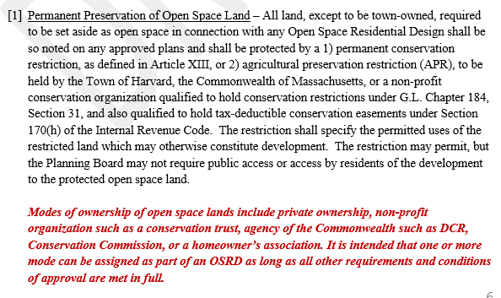
Comments
Permanent preservation of Open Space must be by:
Conservation Restriction
APR
No matter the ownership type.

Slide 30
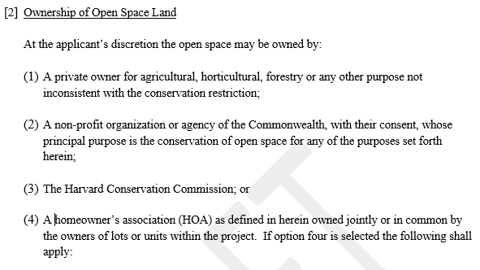
Comments
Ownership of Open Space may be:
Private and use restricted
Non-profit (e.g., Land Trust)
Conservation Commission
Homeowner’s Association
Each project will have a unique portfolio of open space assets and ownership structure will be based on the characteristics of the assets. For example, a playing field may be deeded to Town or HOA for recreation, wetlands may be deeded to ConCom, and a forest may be deeded to HCT.

Slide 31
HOA Ownership Option
Not generally recommended for natural landscapes but may be better suited for active recreational and social areas.
The following is needed if HOA option is chosen:
HOA documents drafted and approved by the Planning Board and Counsel.
Membership mandatory for all property owners including fees
HOA responsible for liability insurance, property taxes, and all maintenance
Failure to pay fees shall constitute a lien on property
Fees adjustable based on needs
HOA seeded with a conditional grant
Tax lien conditions
Final documents approval by Town Counsel

Slide 32
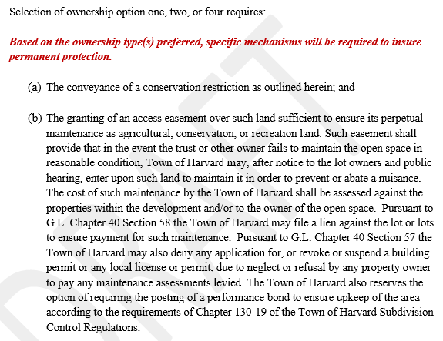
Comments
Ownership type of Open Space can require:
Conservation Restriction
Access Easement for Maintenance
This would not be required for conveyance to ConCom.

Slide 33
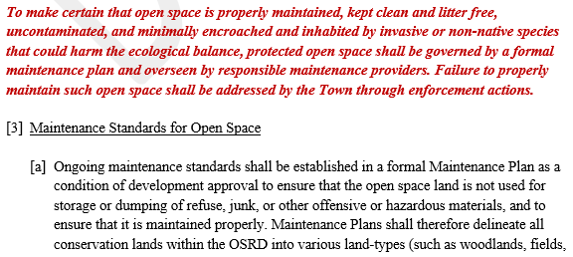
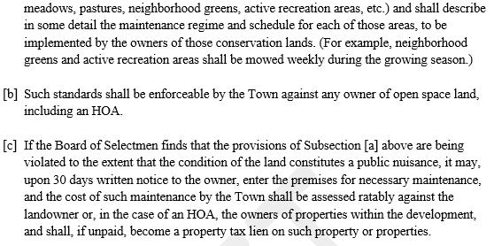
Comments
Maintenance of Open Space involves a formal Maintenance Plan (MP). This plan shall be responsible for all common area if a HOA but will only apply to OS if other option.
Failure to maintain as per MP gives the authority to Town to conduct the necessary repairs and assess the landowner for the cost.

